Slide 1
CHEST OPACITY CLASSIFICATION
By
Sulaiman Kagumire
2100702296
2021/HD05/2296U

Slide 2
Outline
Data balancing
Train-valid-test-split
Image Preprocessing
Model Architecture
Results
Model Evaluation
Model Testing
Work in Progress

Slide 3
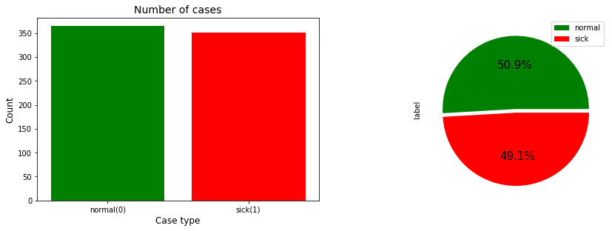
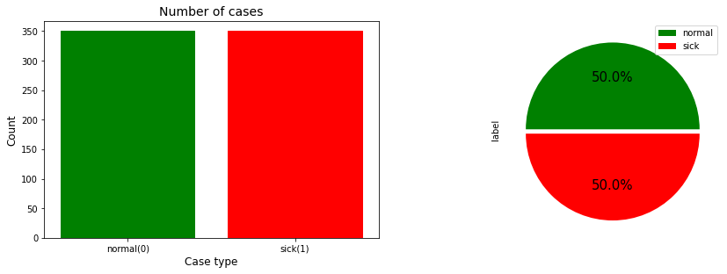
Data Balancing
Fig.1 Imbalance Data
normal | 364
sick | 351
Fig.2 Balanced Data
normal | 350
sick | 350

Slide 4
Train-valid-test-split
 | normal | sick | Total
train | 224 | 224 | 448
valid | 70 | 70 | 140
test | 56 | 56 | 112

Slide 5
Image Preprocessing
Image resizing: 150 x 150
Data Augmentation
Rescaling - Input normalization

Slide 6
Model Architecture
Model - ResNet50V2
Excluded fully connected layers
Froze trainable layers
Added One Dense layer and output layer - softmax activated
Callbacks
ReduceOnPlateau
ModelCheckpoint
Learnng rate - 0.0001
Metrics - accuracy and AUC (Area under the ROC curve)
Notes:
Freeze so as to avoid destroying any of the information they contain during future training rounds

Slide 7
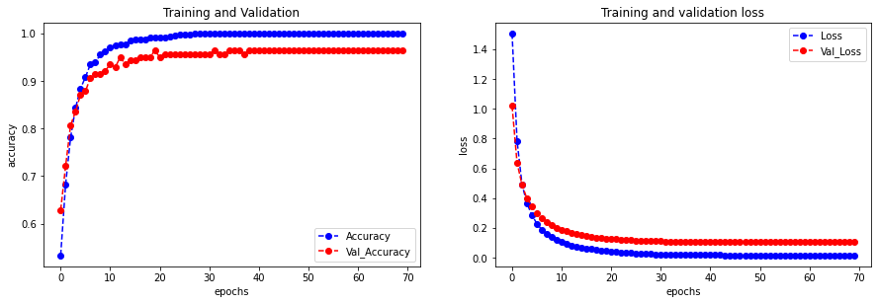
Results

Slide 8
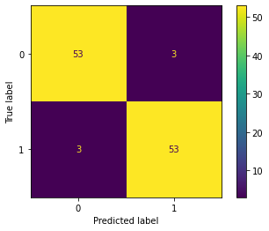
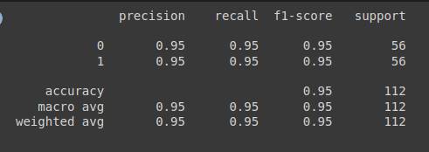
Model evaluation

Slide 9
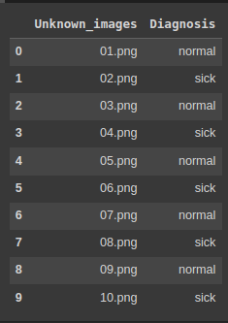
Testing - Unknown images

Slide 10
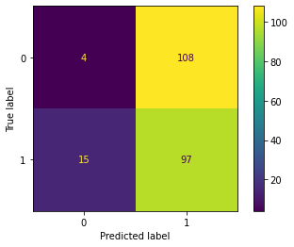
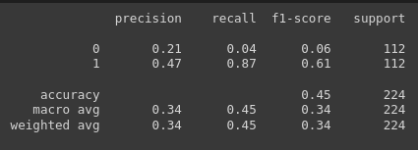
Testing - Dataset2

Slide 11

Improving performance for dataset2
In Progress
Using Vision Transformers

Slide 12
THANK YOU

